Slide 1
Secure Data Hiding in Image Using Steganography
CAPSTONE PROJECT
Presented By: SAMEER KUMAR SHAHI
Student Name : SAMEER KUMAR SHAHI
College Name : Pillai College Of Engineering
Department : Information Technology

Slide 2
OUTLINE
Problem Statement
Technology used
Wow factor
End users
Result
Conclusion
Git-hub Link
Future scope

Slide 3
Problem Statement
Traditional data encryption methods make hidden messages detectable because they alter the file size or structure. Image steganography hides data within images in such a way that it remains invisible to the human eye, making it an undetectable and secure method of communication.

Slide 4
Technology used
Python – The core programming language used for implementation.
OpenCV (cv2) – For reading, modifying, and saving image files.
NumPy – For handling image pixel data.
LSB (Least Significant Bit) Encoding – A technique to hide messages in the least significant
bits of an image’s pixel values.

Slide 5
Wow factors
Invisible Communication: Hidden messages are embedded within images without changing their appearance.
Undetectable Steganography: Even if someone inspects the image, they cannot see the difference.
Data Security: A simple and effective method to protect sensitive information.

Slide 6
End users
Cybersecurity Experts – To transmit confidential data securely.
Journalists & Activists – To share sensitive information in restricted areas.
Forensic Investigators – For secure communication of classified details.
General Users – For private communication without encryption tools.

Slide 7
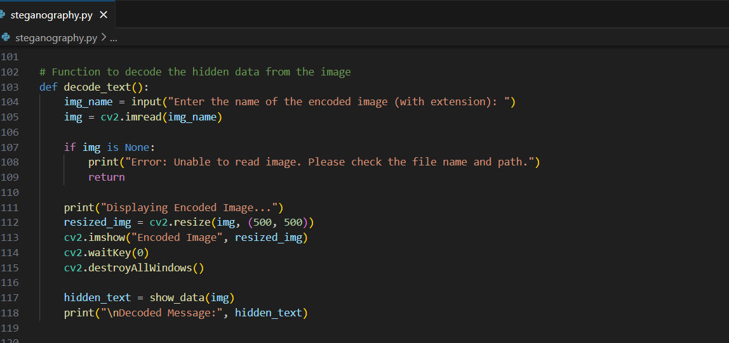
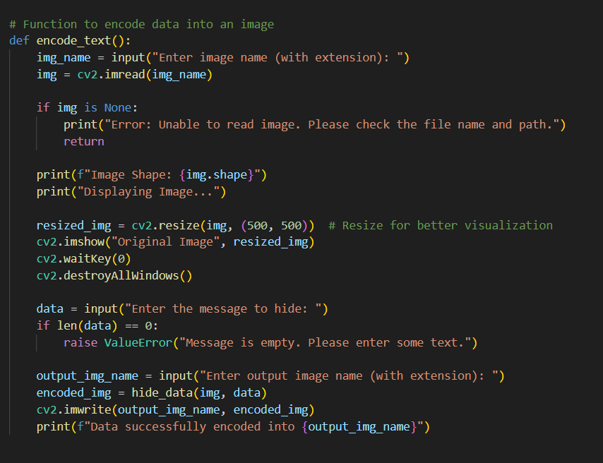
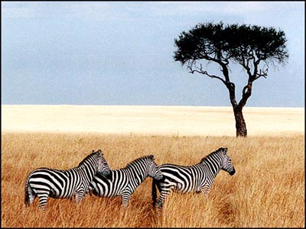

Results

Slide 8
Conclusion
Image steganography provides a secure, invisible, and efficient way to hide messages inside digital images. It is an easy-to-implement method that ensures privacy and confidentiality in communication.

Slide 9
GitHub Link
https://github.com/sameer7585/edunet-foundation_project.git

Slide 10
THANK YOU

